Slide 1
Session Two
PHP has 65% shares in the market which is the majority

Slide 2
We discuss about Something very unique and Something useful for your company In this session learning PHP straight forward.

Slide 3
What you need to run PHP?
A text editor (like Sublime Notepad or Dreamweaver)
A web server to save all the file (Apache)
A database to store data/information (MySQL)
A browser to view the script in (Firefox, Chrome) in short to see the result
XAMMP Package provider all the above …

Slide 4
WHAT CAN BE DONE BY PHP?
We still can create CMS(Content Management System) Using PHP
We can create E-commerce sites using PHP
Facebook, wordpress, joomla & Zend are the live example of PHP
We can create Facebook Applications using PHP
Desktop Applications can also be created now using PHP

Slide 5
PHP v ASP
PHP is an open source web programming language which is free to use and easy to write.
ASP is a framework by Microsoft which is not free and not easy to write.
But
PHP has 65% share in the market which is the majority in web developing world.

Slide 6
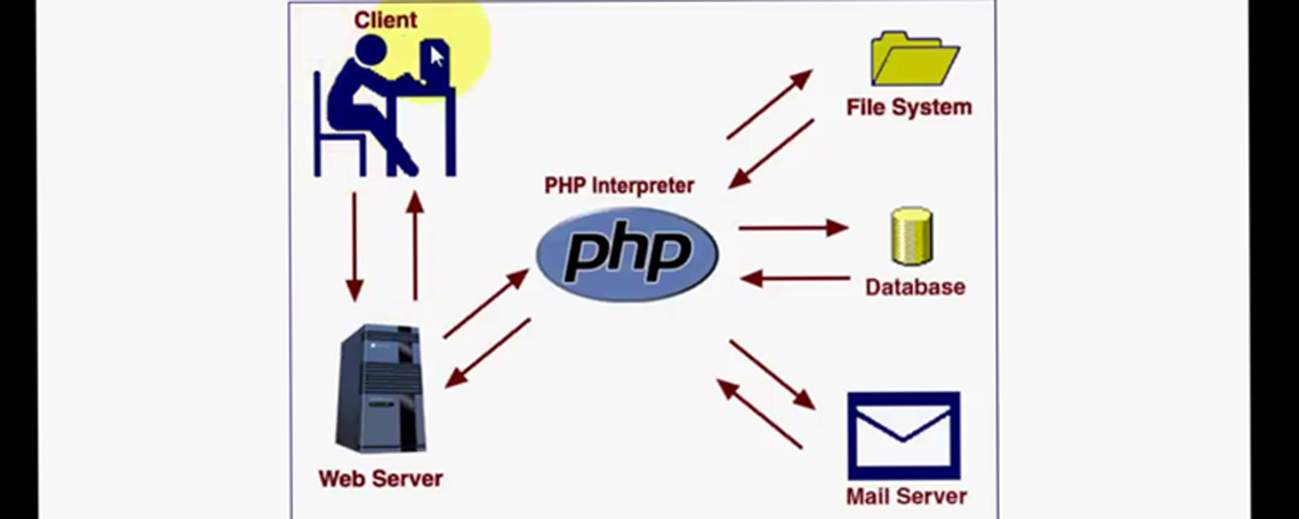
How PHP works ?

Slide 7
In Session 1
PHP Basic
Installation
Syntax
Data type of PHP is d/t from other languages
+, - , *, / if… Else switch loop
End of session one

Slide 8
Session 2 If you want to more info about PHP. We can go to the official website. php.net
PHP Built-in Functions
In PHP, there are more than 700 built-in functions.
Various built-in functions allows for fast development.
Calendar functions
Date functions
PHP Math Functions
PHP File Handling
Etc
This PHP Training classes

Slide 9
PHP user defined function
A function will be executed by a call to the function.
You may call a function from anywhere within a page.
A function is a block of code designed to perform a particular task
Function are used to
1. Increase the readability of program
2. To perform a task in repetitive manner
Create a PHP Function
Syntax
function functionName() { code to be executed; }

Slide 10
PHP Forms and User Input
The PHP $_GET and $_POST variables are used to retrieve information from forms, like user input.
PHP Form Handling
Example
<form action=“test.php" method="post"> Name: <input type="text" name="fname" /> Age: <input type="text" name="age" /> <input type="submit" /> </form>
When a user fills out the form above and click on the submit button, the form data is sent to a PHP file, called “test.php":
“test.php" looks like this:

Slide 11
“test.php" looks like this:
Welcome
<?php echo $_POST["fname"]; ?>!<br /> You are
<?php echo $_POST["age"]; ?> years old.
Output could be something like this:
Welcome Bruck! You are 28 years old.

Slide 12
Form Validation
User input should be validated on the browser whenever possible (by client scripts). Browser validation is faster and reduces the server load.
we use the isset() function to find out if User Input a has been set.
You should consider server validation if the user input will be inserted into a database.
The user will then get the error messages on the same page as the form. This makes it easier to discover the error.

Slide 13
PHP $_GET Function
The built-in $_GET function is used to collect values in a form with method="get".
As an Example
When to use method="get"?
When using method="get" in PHP forms, all variable names and values are displayed in the URL (it will be displayed in the browser's address bar).
Note: This method should not be used when sending passwords or other sensitive information!
However, because the variables are displayed in the URL, it is possible to bookmark the page. This can be useful in some cases.
Note: The get method is not suitable for very large variable values. It should not be used with values exceeding 2000 characters.

Slide 14
PHP $_POST Function
The built-in $_POST function is used to collect values in a form with method="post".
As an Example
When to use method="post"?
Information sent from a form with the POST method is invisible to others and has no limits on the amount of information to send.
However, because the variables are not displayed in the URL, it is not possible to bookmark the page.

Slide 15
The PHP $_REQUEST Function
The PHP built-in $_REQUEST function contains the contents of both $_GET, $_POST, and $_COOKIE.
The $_REQUEST function can be used to collect form data sent with both the GET and POST methods.
As an Example

Slide 16
End of Session two

