Slide 1
Session One
PHP has 65% shares in the market which is the majority

Slide 2
We discuss about Something very unique and Something useful for your company In this session learning PHP straight forward.

Slide 3
Php Basic
Php overview
Hypertext Preprocessor (originally named Personal Home Page Tools)
Invented by Rasmus Lerdorf in 1994 and is now under the Apache Software Foundation.
Supports many types of databases: MySQL, Oracle, ODBC (for MS Access and SQL Server), SQLite, etc
WAMP, LAMP, and MAMP
WAMP is an acronym for Apache, MySQL, and PHP on Windows.
LAMP is an acronym for Apache, MySQL, and PHP on Linux.
MAMP is an acronym for Apache, MySQL, and PHP on Macintosh.

Slide 4
Php overview
Apache, PHP, and MySQL
Apache is a free open source Web server. Apache has been the most popular web server on the Internet since April 1996. According to a recent Netcraft survey 62% of all Web sites on the Internet are using Apache. This makes Apache more widely used than all other Web servers combined. Microsoft’s Web server named Microsoft IIS has less than a third of the market share.
PHP is a free open source scripting language designed for producing dynamic, database-driven web pages. PHP is a recursive acronym for "PHP: Hypertext Preprocessor". PHPis installed on more than 20 million websites and 1 million web servers.
MySQL is a free open source relational database management system (RDBMS). MySQLhas more than 11 million installations..
PHP is a scriptinglanguage – it gets interpretedinstead of being compiledlike C++ and Java.

Slide 5
Php overview
Unlike JavaScript which is executed by the web browser, all PHP code is executed on the web server.
The syntax is very similar to Perl and
Variables are case sensitive, function names are not, and statements must be terminated with a semicolon.
PHP code should be placed between <? code?>or <?php code?>tags.
The second method is preferred so your scripts are XML compatible. There is no limitation as to where PHP code can be inserted.
To see information about how PHP is configured, version information, and the settings of all environment variables (e.g., HTTP_USER_AGENT and QUERY_STRING),call the phpinfo()function in any script.

Slide 6
Php overview
The php.inifile is the main configuration file for PHP. It can be edited by the system administrator tochange any of the configuration settings. A changeto this file requires the web server be restarted sincethe file is only read once when the web server starts up. (The phpinfo()function reports the location of php.ini on the server.)
It’s a good idea to turn on error and warning output when developing your code so you don’t misuse PHP syntax in unintended ways. Place the following lines of code at the top of your script so errors will be reported in the rendered web page:
ini_set('display_errors', '1');
error_reporting(E_ALL | E_STRICT);

Slide 7
Php installation
Start any kind of setup and version you have then follow the promots(XAMP,WAMP)
For wamp server When installation window pops up with the promot ‘choose browser’ , choose your prefered internet browser.

Slide 8
Syntax&Variable
Comments
The three following styles are legal:
# Perl style single line comment
// Single line comment
/* Multiple
line comments */
Always starts with $ and letter or underscore. Can be composed of numbers, underscores, and letters.
$my_var = 10;
$a_2nd_var = "bison";

Slide 9
Syntax&Variable
Data types: integers, doubles (numbers with a decimal point), boolean (true or false), NULL, strings, arrays, objects, and resources (like database connections).Variables do not have to be declared and neither do their data types.
Variables have a default value (0, empty string,false, or empty array) if they aren’t initialized before trying to use them. It’s always good practice to initialize all variables rather than relying on the default initialization value. If you try to use a variablebefore setting it to a value, strict error-reporting setting will give you an “Undefined variable” warning.
All variables have local scope (i.e., they are accessible only within the function or block in which they are initialized). Global variables may only be accessed within a function by using the globalkeyword.
$x = "test";
function display() {
global$x;
echo $x;
}

Slide 10
Syntax&Variable
Constants are defined using defineand by convention are usually named in ALL CAPITALS.
define("PI", 3.14);
define("HEADING", "<h1>My Web Site</h1>");
$area = PI * $radius * $radius;
print(HEADING);

Slide 11
Php operation
Assignment
= += -= /= *= %= ++ --- like most programming languages.
= - string concatenation operator (see strings section).
Arithmetic
+ - * / % - like most programming languages.
Comparison
== != <><= >= like most programming languages. Also <>is the same as !=.
=== true if arguments are equal and the same data type.
!== true if arguments are not equal or they are not of the same data type.
Logical
&& and || like most programming languages (&&and ||short-circuit) and or - like &&and ||but have lower precedence than &&and ||.
xor- true if either (but not both) of its argumentsare true.
Print and echo are used to print to the browser.
echo"Go Bisons";

Slide 12
Php operation
echo("Go Bisons"); // same thing
print("Go Bisons"); // same thing
printcan only accept one argument, and echo can accept any number of arguments. Printreturns a value that indicates if the print statement succeeded.
Variables are interpolated inside of strings unless single quotes are used.
$a = "guts";
echo "You have $a."; // prints "You have guts."
echo 'You have $a.'; // prints "You have $a."
Escape sequences: \n (newline), \r (carriage-return), \t (tab), \$ ($), \” (“), \\ (\)
echo "a\\b\tc\$d"; // prints "a\b c$d"
echo 'a\\b\tc\$d'; // prints "a\b\tc\$d". Only \\ is converted.
Printf works like C’s counter-part.
$title = "X-Men";
$amount = 54.235;
printf("The movie <b>%s</b> made %2.2f million.", $title,$amount);
// prints "The movie <b>X-Men</b> made 54.23 million."

Slide 13
Php operation
Output shortcut from within HTML:
Hello, <b><?= $name ?></b> is the same as Hello, <b><?php echo $name ?></b>
Choice structures
if($x > 0)
$y = 5; // {} not required for only one statement
if($a) { // tests if $a is true or non-zero or anon-empty string
print($b);
$b++;
}
else
print($c);
if($a > $b)
print "a is bigger than b";
elseif($a == $b) // use "elseif" or "else if"
print "a is equal to b";
else
print "a is smaller than b";

Slide 14
Php operation
switch($vehicle_type) { // works for integers, floats, or strings
case"car": $car++;
break;
case"truck": $truck++;
break;
case"suv": $suv++;
break;
default: $other++;
}
Looping structures
while($n < 10) {
print("$n ");
$n++;
}
do{
print("$n ");
$n++;
} while($n < 10);

Slide 15
Php array
Array
(
[CO] => Denver
[AR] => Little Rock
)
Pull values out of an array:
$colors = array("red", "green", "blue");
list($c1, $c2) = $colors;
print("$c1 and $c2"); // prints "red and green"
Delete from an array:
unset($colors[1]); // $colors now contains red and blueat indexes 0 and 2.
Extracting array keys and values:
$states = array_keys($capitals); // $states is ("CO", "AR")
$cities = array_values($capitals); // $cities is ("Denver", "Little Rock")

Slide 16
Php array
Iterating through an array:
$heroes = array('Spider-Man', 'Hulk', 'Wolverine');
foreach($heroes as $name)
print("$name<br />"); // prints all three in order
foreach($capitals as $state => $city)
print("$city is the capital of $state.<br />");
Treat an array like a stack:
array_push($heroes, 'Iron Man'); // Pushed onto end of array
$heroes[] = 'Captain America'; // Same thing as array_push
$h = array_pop($heroes); // Pops off last element (Iron Man)
Size of an array:
$num_items = count($heroes); // returns 3
Sort an array:
sort($heroes); // Heroes are now in alphabetical order (lowest to highest)
rsort($heroes); // Reverse alphabetical order (highestto lowest)

Slide 17
Php loop
For loop
for( initialization; condition; increment ){
loop body
}
Foreach loop
foreach( array as [key=>]value ){
loop body
}
Example
$arr = array(“name”=>”Abebe”, “dept”=>”CS”, “year”=>3, “cgpa”=>3.5);
foreach( $arr as $key=>$value ){
echo $key . “ = “ . $value . “<br>”;
}
//output

Slide 18
Php loop
name = Abebe
dept = CS
year = 3
cgpa = 3.5
While loop
while( condition ){
loop body
}
Do-while loop
do{
loop body
}while( condition );
break
ends execution of the current for, foreach, while, do-while or switch structure.
accepts an optional numeric argument which tells it how many nested enclosing structures are to be broken out of.

Slide 19
Php loop
continue
used within looping structures to skip the rest of the current loop iteration
execution continues at the condition evaluation and then the beginning of the next iteration
return
If called from within a function, the return statement immediately ends execution of the current function, and returns its argument as the value of the function call
If return is called from within the main script file, then script execution ends.

Slide 20
What you need to run PHP?
A text editor (like Sublime Notepad or Dreamweaver)
A web server to save all the file (Apache)
A database to store data/information (MySQL)
A browser to view the script in (Firefox, Chrome) in short to see the result
XAMMP Package provider all the above …

Slide 21
WHAT CAN BE DONE BY PHP?
We still can create CMS(Content Management System) Using PHP
We can create E-commerce sites using PHP
Facebook, wordpress, joomla & Zend are the live example of PHP
We can create Facebook Applications using PHP
Desktop Applications can also be created now using PHP

Slide 22
PHP v ASP
PHP is an open source web programming language which is free to use and easy to write.
ASP is a framework by Microsoft which is not free and not easy to write.
But
PHP has 65% share in the market which is the majority in web developing world.

Slide 23
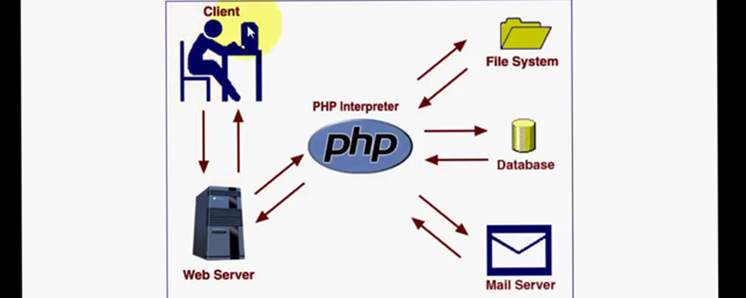
How PHP works ?

Slide 24
End of Session One

